Slide 1
Attainment 8
The average measure of an individual student’s progress across their 8 best performing subjects which fall into three buckets.
Progress 8
This is a measure of students’ progress across 8 subjects. This is a value added measure whereby students’ results are compared to students who had the same prior attainment score at KS2. It uses the same buckets as Attainment 8.

Slide 2
Buckets
Bucket 1: English and Maths
The score for Maths and English will be double weighted.
Bucket 2: Three highest Ebacc subjects, which are as follows:
• Separate Sciences
• Core & Additional Sciences
• Computer Science
• History
• Geography
• Languages
Bucket 3: Three ‘other’ subjects in which students have received their highest grades.

Slide 3
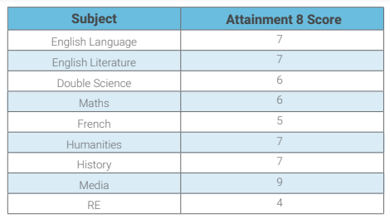
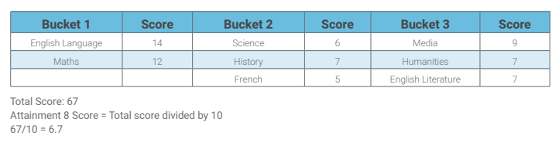
Amy achieved the following grades in her examinations:

Slide 4
Calculating a student’s Progress 8 score
Amy’s Attainment 8 score = 67
Amy’s estimated Attainment 8 score = 59.95
Progress 8 score = (67 – 59.95) / 10 = 0.71

